Slide 1
LMS Review Process

Slide 2
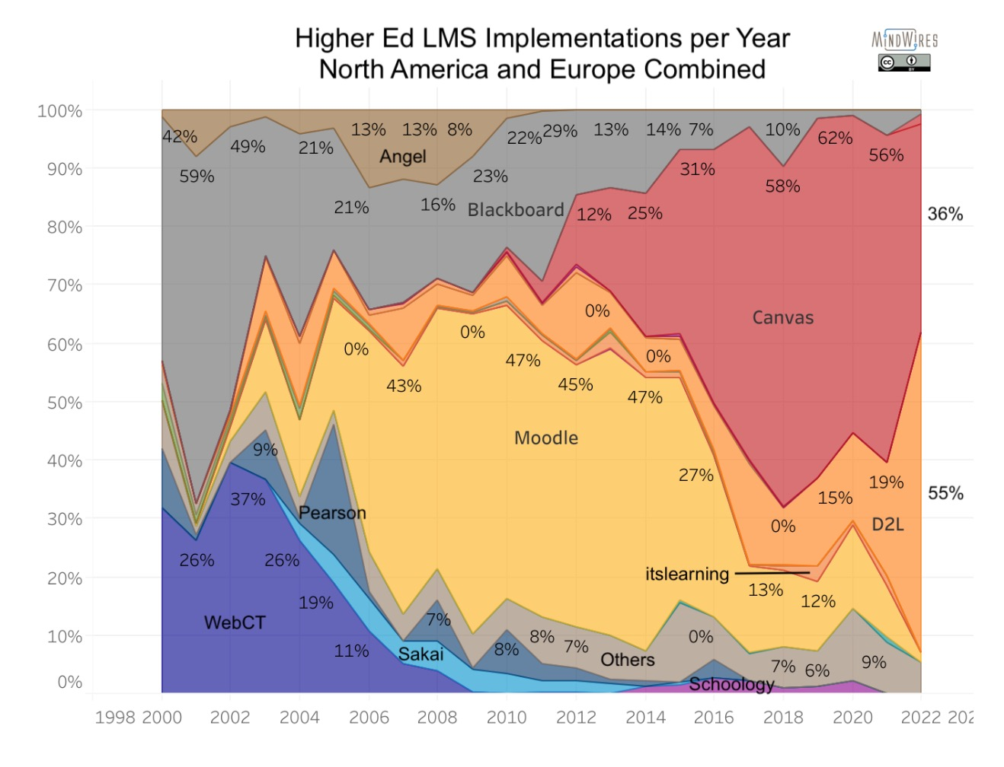
Higher Ed LMS Implementations Per Year North America and EUROPE
Post-Conference LMS Market News by Phil Hill November 6, 2022

Slide 3
LMS Review Website https://www.uhonline.hawaii.edu/uh-lms-review/
LMS Vendors – Recordings available from faculty and student demonstrations
LMS Review Team Roster – Student, Faculty, and ID representation across all ten campuses
UH LMS Evaluators - Sign-up by Friday, February 3, 2023)
Town Hall Sessions - Six sessions to choose from Feb. 6-24, 2023)
FAQs

