Slide 1
2018 Network Updates
chris zane
czane@hawaii.edu

Slide 2
Interisland Upgrades
Fall 2017 : Upgraded Interisland capacity, Shared with ETS
200 Gbps : Oahu - Maui - Big Island
100 Gbps : Oahu - Big Island
100 Gbps : Kalanimoku - UH Manoa
Oahu-Maui-Big Island : 40 Gbps Ring
Kauai : Dual 10 Gbps
Molokai & Lanai : 10 Gbps each
Collaboration with ETS for redundant circuits from key locations

Slide 3
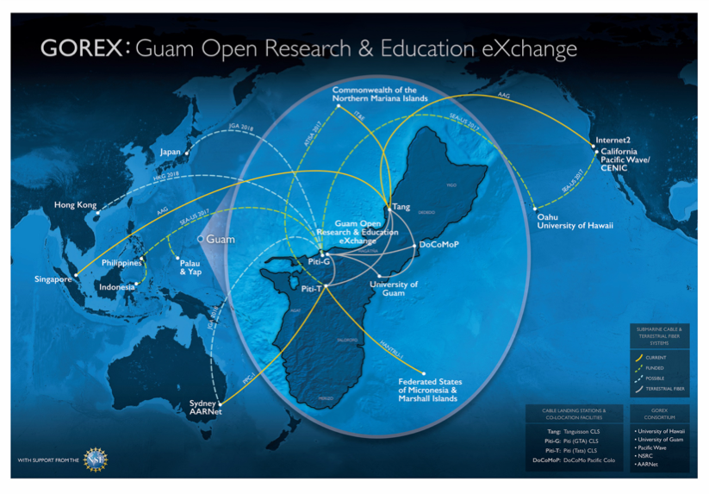
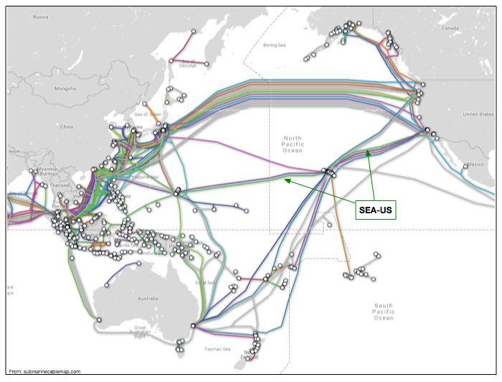
Trans-Pacific - 100 Gbps
Jan 2018 : 100 Gbps on SEA-US
100 Gbps : UH Manoa - Los Angeles
100 Gbps : UH Manoa - Guam
100 Gbps access to Internet2 in LA
GOREX - Guam Open Research & Education eXchange
Connectivity to Asia-Pacific
University of Guam at 10 Gbps

Slide 4
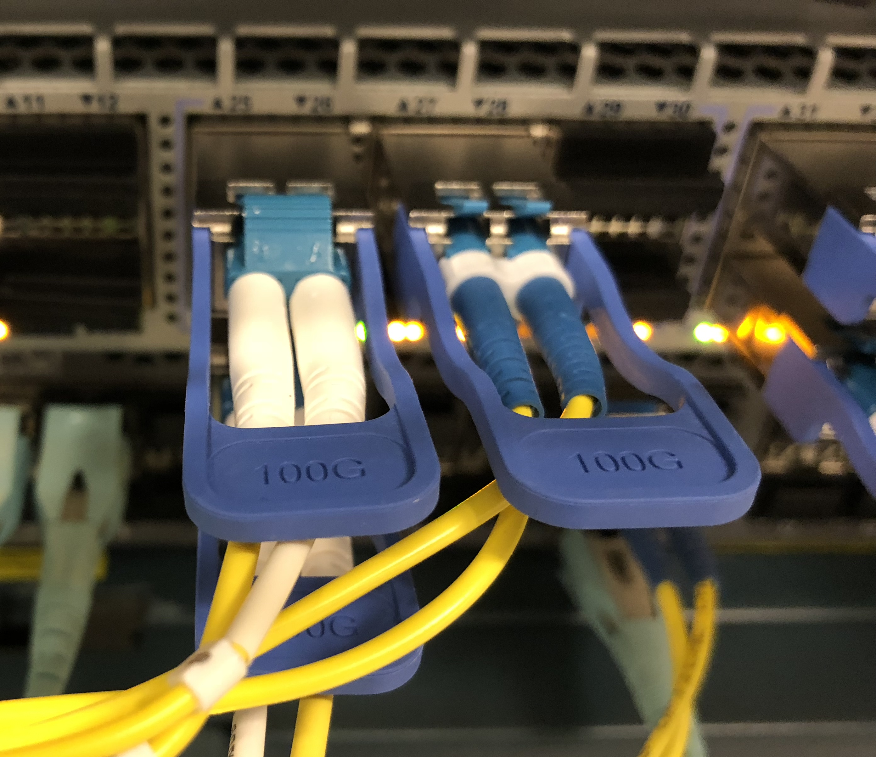
UH GigaPOP 100G Upgrades
UH GigaPOP upgraded to 100 Gbps
Internet2 (Los Angeles) @ 100 Gbps
AARNet (Australia, Seattle) @ 100 Gbps
GOREX (Guam) @ 100 Gbps
10 Gbps to Seattle & Los Angeles
SciDMZ Upgraded to 100 Gbps
SciDMZ users access @ 10/25/40/50/100 Gbps

Slide 5
Annual IPv6 Plug
Annual Reminder for IPv6
UH Manoa WiFi network usage is 60% IPv6
Start with networks
All network subnets should have IPv6 on them
Application & Developers
Use DNS names, don't use IPv4 addresses

Slide 6
Thank You!

