Slide 1
IT Service Management & Cherwell
Dan Schumacher

Slide 2
What is IT Service Management (ITSM)?
“Simply put, it refers to all the activities involved in designing, creating, delivering, supporting and managing the lifecycle of IT services.”
IT Service Management

Slide 3
Common Benefits include:
Reduce IT costs
Improve quality of service
Improve customer satisfaction
Improve governance and reduce risk
Increase competitive advantage
Improve flexibility
Increase agility for new IT services
ITSM Benefits

Slide 4
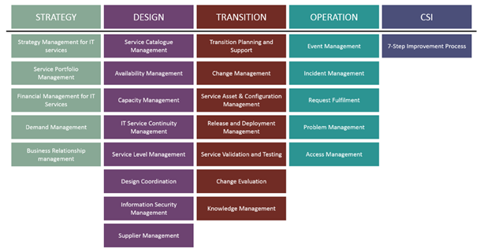
IT Infrastructure Library (ITIL) V3
Notes:
Service Catalog, Service Desk, Incident Management, Change Management, Service Asset & Configuration Management
Service Strategy - 5
Service Design - 8
Service Transition - 7
Service Operations - 5
Continuous Service Improvement – 7 Step Improvement process

Slide 5
RFP released last summer
Awarded to Avante (implementer) for Cherwell ITSM tool suite
Finalizing the contract and the implementation statement of work
Estimate ~3.5 months to deliver the project
ITSM Project

Slide 6
Want to Learn More?
What: ITS-Talks on ITSM
Where: ITC
When: July 25th, 1:30 pm

