Slide 1
UH HPC Cluster Update Ron Merrill July 13, 2018
Notes:
Good morning, as the slides says I am Ron Merrill, the High Performance Computing Manager with the ITS Cyberinfrastructure (CI) group

Slide 2
Outline
What is the HPC cluster?
Why is there an HPC?
Who uses the HPC?
What’s new with the cluster?
Notes:
My title job title has, HPC in it, but high performance computing, is just one aspect of CI’s efforts to support the UH research mission.

Slide 3
What is the UH HPC Cluster?
290 Compute Nodes
6168 Cores Total
Ivy bridge, Haswell, Broadwell
49.1 TB RAM Total
128 GB, 256 GB, 1024 GB
~ 2/3 Community owned

Slide 4
Cray CS-300

Slide 5
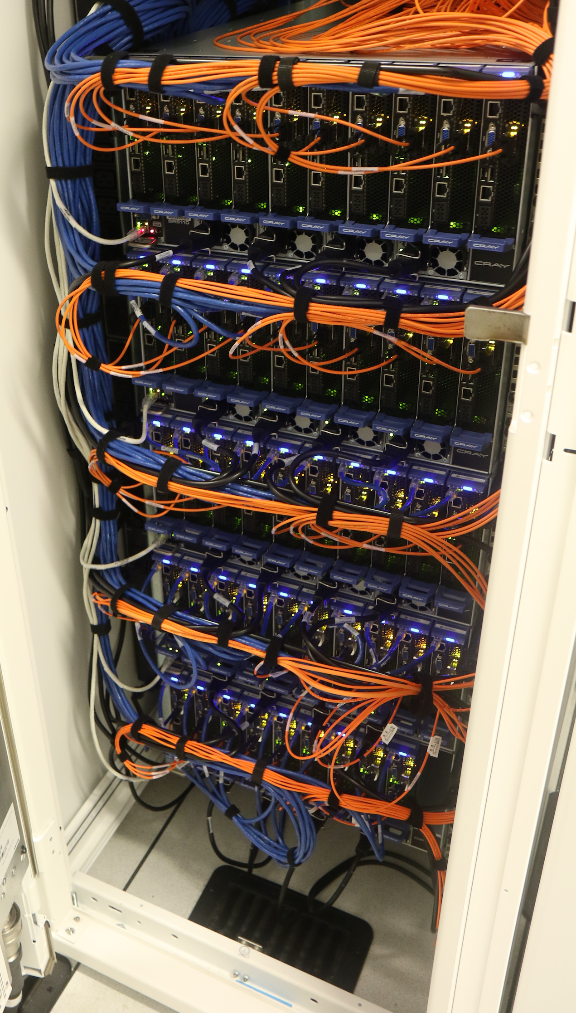
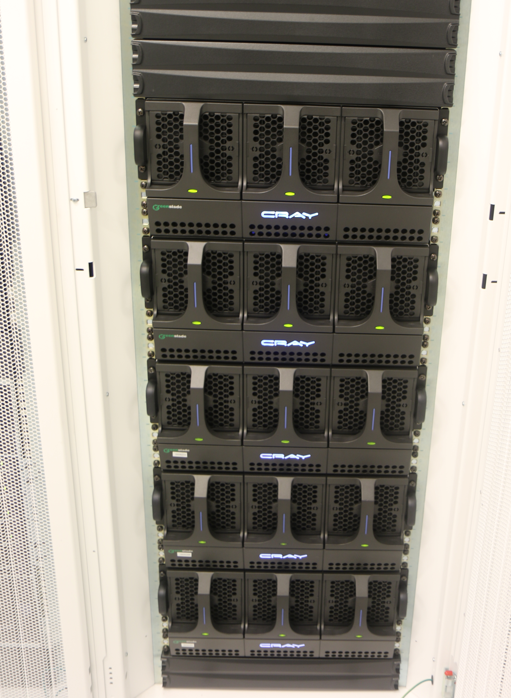
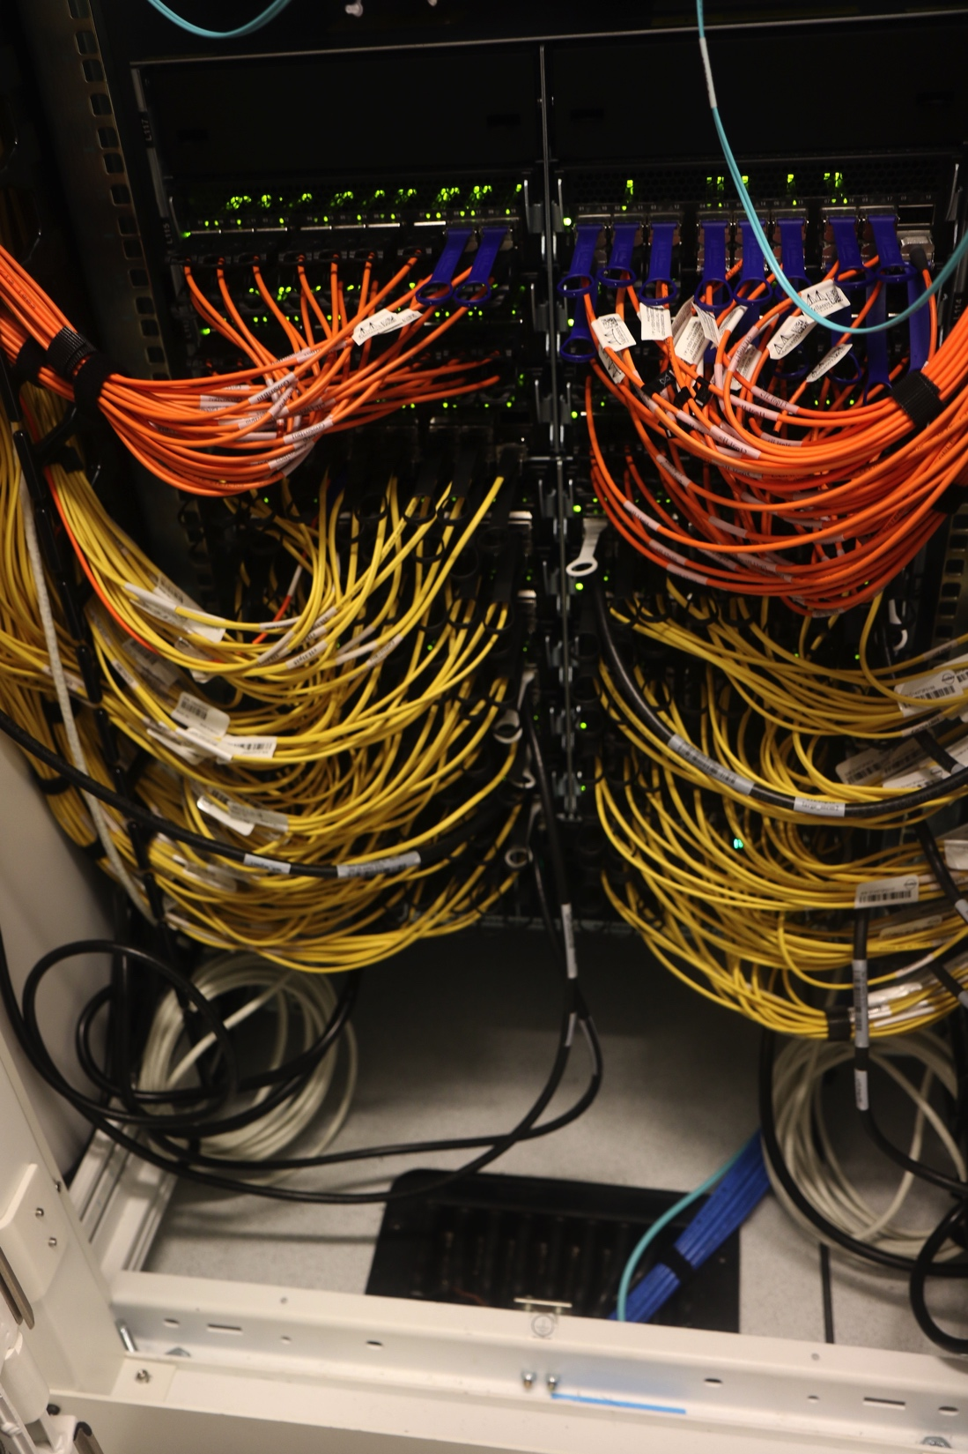
HPC

Slide 6
Why is there UH HPC Cluster?
Researchers need computers
Modeling and analysis
Research compute tasks come in many sizes
Desktop
Clusters
PI, Departmental, Campus
National supercomputers
Commercial clouds
Notes:
My title job title has, HPC in it, but high performance computing, is just one aspect of CI’s efforts to support the UH research mission.

Slide 7
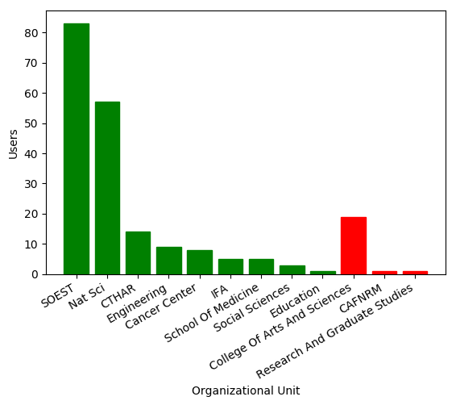
Who uses the HPC?
Notes:
Active users by campus (b) Active users by OU at UH Mānoa (green) and UH Hilo (red)

Slide 8
UH HPC Update
Replace ACE - Cray cluster management
Vendor locks hardware purchase
Whole cluster co-term warranty
OS upgrade for fee only
xCAT - Extreme Cluster/Cloud Administration Toolkit
Open source, hardware and OS agnostic
Replace management and login nodes with dedicated VM cluster
Enables further expansion of the cluster

Slide 9
CI People
Gwen Jacobs, Director
Sean Cleveland
David Schanzenbach
Michelle Choe
Jennifer Geis
Ouida Meier
Adriana Comerford

Slide 10
Thank you!

