Slide 1
The Hawai‘i Data Science Institute
Gwen Jacobs
Director of Cyberinfrastructure

Slide 2
HI-DSI Goals
Develop educational degree programs designed to increase enrollment and retention in data science at the undergraduate, graduate and professional levels,
Catalyze interdisciplinary research projects and extramural funding
Develop strong partnerships with industry and the business community to support workforce development and training.
Co-Directors: Jason Leigh and Gwen Jacobs
Associate Director.

Slide 3
Education and Training
Disruptive, cross campus curriculum development effort
Foundational Data Science course for all students
1 credit modules of core data science topics – Juypter notebooks – increase access for all
1 – 2 day workshops on focused topics
Certificate in Data Science
Challenge – coordination of efforts across campus

Slide 4
Research
Promote collaborative research between data scientists and domain scientists
HI-DSI Student Fellowships
Students learn basic data science skills
Introduction to Python Programming, Data Wrangling, Data Visualization, Modeling through Probabilistic Programming, Data management and database architecting and querying, Time Series Data Analysis, Introduction to Machine Learning
Work with industry partners and domain scientists on research projects

Slide 5
Industry Partners
Connect with and engage industry partners to partner on research projects, support internships for UH Data Science students and industry jobs
Hawaiian Airlines
American Savings Bank
Hawaiʻi Permanente Medical Group
Hawaiʻi Pacific Health
First Hawaiʻi Bank

Slide 6
CI-Lab
ITS has a research laboratory!
Keller 103 transformed into a collaborative workspace, meeting and demo space
Supports ITS collaborative research/education projects: ‘Ike Wai, HI-DSI, PIREN, AGAVE and more….
Opening August 2018

Slide 7
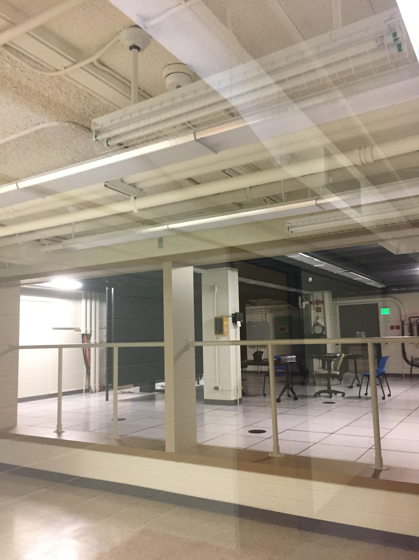
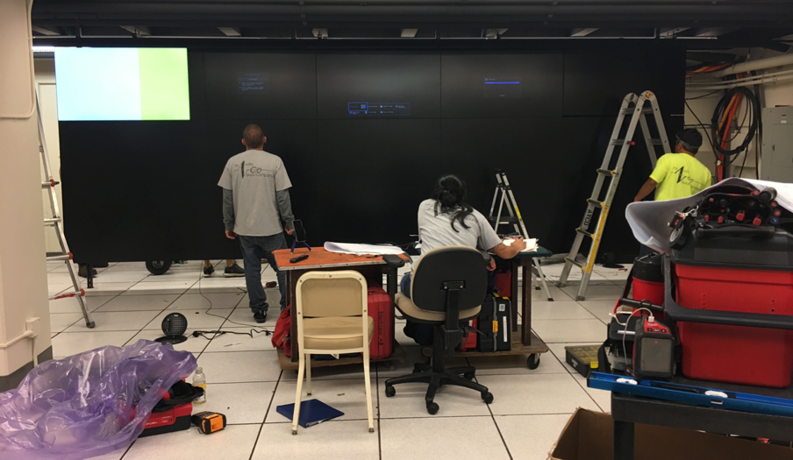
Mahalo!

