Slide 1
Cybersecurity & Data Governance
Jodi Ito
Chief Information Security Officer
jodi@hawaii.edu

Slide 2
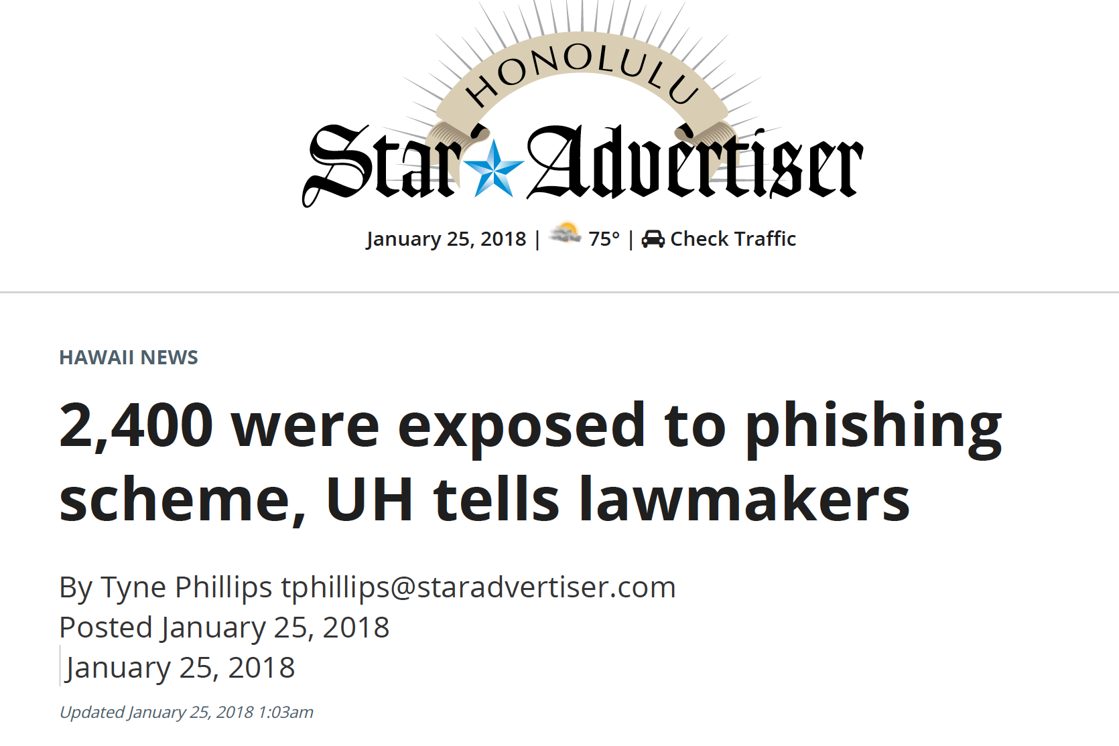
NOTE: some items in article are inaccurate
http://www.staradvertiser.com/2018/01/25/hawaii-news/2400-were-exposed-to-phishing-scheme-uh-tells-lawmakers/

Slide 3
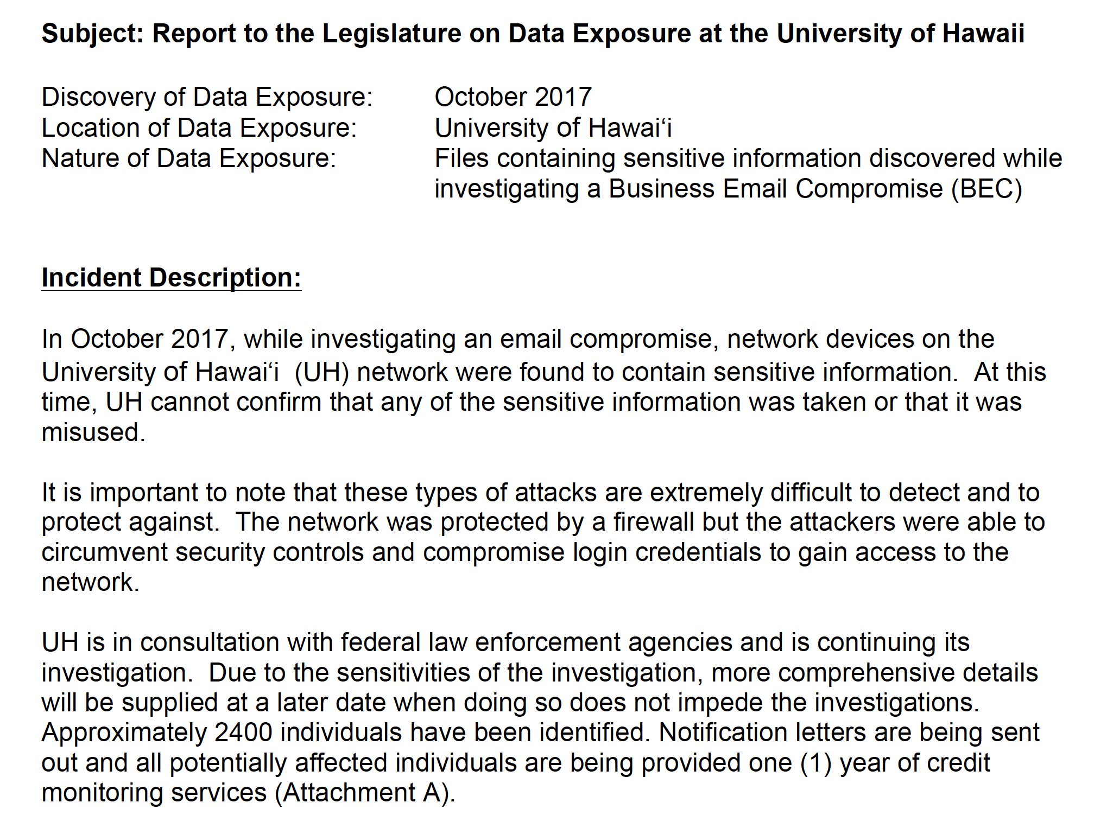
http://www.hawaii.edu/govrel/docs/reports/2017/hrs487n-4_2017_october-2017-breach_report.pdf

Slide 4
Top Security Concerns
Increase in cyber attacks + better methodologies = increase in compromised systems, networks, and accounts
Increase in well-crafted SPEAR phishing attacks appearing to be sent from UH employees/departments
Privileged account credentials are stolen (Active Directory Domain Administrator accounts, system administrator accounts, credit card processor accounts, etc.)
Misperception that if your computer/network is behind a firewall, you are secure (email attacks can bypass firewalls)

Slide 5
Security Concerns - continued
Contract language for 3rd party hosted applications/services storing UH sensitive information is not vetted so UH sensitive information is NOT adequately protected
Human error: UH sensitive information is still being mishandled
emailed to the wrong person unencrypted
faxed to the wrong phone number
inadvertently posted on a public website
Google docs/drive being used to share sensitive information

Slide 6
Data Governance & Info Sec Road Shows
Presentations on every campus this past spring including an online session
overview of UH Data Governance principles & guidelines, update of related policies & procedures, overview of Information Security Program, data classification categories, HIPAA policy and more
archive of online session & slide decks posted on:
www.hawaii.edu/uhdatagov
Planning for similar sessions in Fall

Slide 7
Today’s Security Sessions
Security Incident Response & Current Threats at UH (repeated)
What is a “security incident”; what do if you have one (CALL INFOSEC!); what information you should be logging/monitoring; forensics for analysis; remediation steps (do not restore the malware!); threat landscape & incidents
Everyday Cybersecurity Tips for Non-Geeks (Breakout #1)
Threat landscape & incidents (who’s attacking us and why); UH policies & procedures (protecting UH sensitive information); “Good Cyber Hygiene” practices to use every day
Everything You Wanted to Ask… about cybersecurity (Breakout #2)
Open Q&A session: panel includes Data Governance, Info Sec, Office of General Counsel

