Slide 1
Early College High School as a strategy to meet
55 by 25
Windward Community College
Looking to the future: Enrollment, Outreach and Student Support
Ardis Eschenberg, Ph.D.
Vice Chancellor for Academic Affairs
Windward Community College
July 13, 2018

Slide 2
Overview
67 slides with nothing but
data charts

Slide 3
ITS and Administration
When it’s going right…
“Yay! I logged into BANNER and was able to check prerequisites.”
“They really did a great job reminding me to turn in TE completion reports!”
      Said no one ever
Everyone knows when something goes wrong
“BANNER is down!”
“Two classes are scheduled for one room!”
Notes:
Both of us are firefighters. We are putting out and preventingthose fires all day long to provide education for our state.
When systems work, we take them for granted. It is when they fail that we notice... And actually this is just emblematic of education in general…

Slide 4
55 by 25
By 2020,
70% of jobs in Hawaiʻi will require
some college
In 2016,
44% of HI Working Age Adults had
a 2 or 4 yr degree
Georgetown University Center on Education and the Workforce
Notes:
Higher Education in Hawaii is failing to keep up with market demand.
1 out of every 3 of our generally better paying jobs will need to go unfilled or be recruited from elsewhere.
56% of our population will be competing for 30% of the remaining jobs, which usually wonʻt even pay a living wage if they get hired.

Slide 5
In the Winter, 2012 People’s Pulse survey of Hawaiʻi residents statewide,
17% of residents said a college education was “not necessary,”
an increase of 13 percentage points since the Fall, 2006 study, in which only 4% of residents answered in the same.
Notes:
The roof is on fire and weʻve quadrupled the number of people who arenʻt worried about the house burning down on them.

Slide 6

Is a college degree necessary in Hawaiʻi?
Living Wage:
$33,349 -> $85,313 ~$53,000*
What living wage job doesn’t require a college degree?
http://livingwage.mit.edu/counties/15003
http://twentytwowords.com/this-is-the-salary-youll-need-to-afford-a-home-in-each-of-the-50-states/
Notes:
$153,000 if you want a house

Slide 7


Slide 8
To change this, we have to get more people in higher ed and keep them
STAR GPS registration – make reg easy & supported
Laulima upgrades – better learning environments
OER – affordability
Course Evaluation System – learn about the student experience

Slide 9
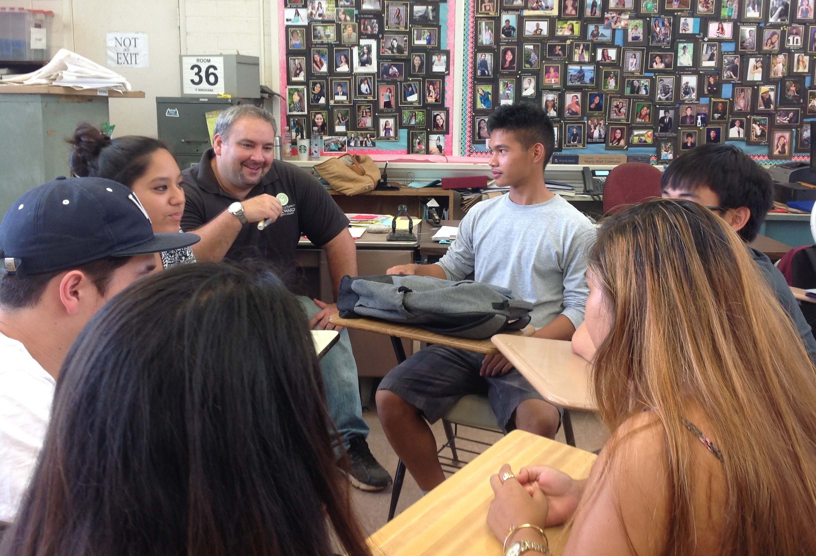
Early College High School
Get more students in the door
  Specifically those who are less likely to come (AP)
  Address the 56%
Build them up to succeed
Notes:
They donʻt need to know the roof is on fire, we just need to give them the skills so they can succeed and help their families and communities to do similarly

Slide 10
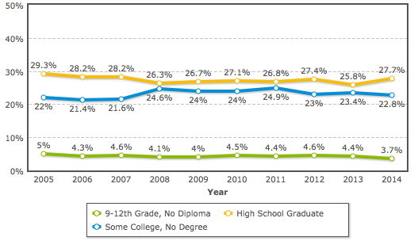
The 56% are almost as likely to have some college as only a HS Diploma
Notes:
*Doesnʻt include less than 9th grade.

Slide 11
Early College High School
Get more students in the door
  Specifically those that are less likely to come (AP)
Build them up to succeed
  Structure the environment so they learn college going skills and are ready to succeed in less supported, less familiar environment
Keep them going
  Improve the pathway so they go on to college after HS
Notes:
Ed is important
ECHS is important not just demographics but opinions, makes it important, likely, less optional

Slide 12
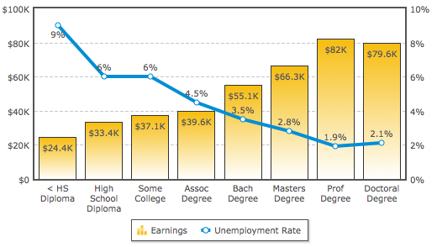
Higher degree = more pay, less unemployment
Notes:
2014
Living wage fall in Bachelor’s Degree, where we meet “virtually no unemployment”
Hawaii residents with bachelor’s degrees earn on average $27,000 more per year than residents with only a high school diploma, and are less likely to be unemployed. (U.S. Census, 2011)

Slide 13
The structure of Early College at WCC
Prioritize underrepresented populations in higher ed:
  1st generation, Native Hawaiian, Free/reduced lunch
Remove the barriers of expense, transportation, unfamiliar environment, isolation:
  Free, in the high school classroom, with their peers
Notes:
In the door, grab the students who donʻt know the roof is on fire or donʻt come from a background that can guide them easily

Slide 14
ECHS building college skills
Support students so they when they fall, they can get back up
  Engaged faculty
  High school success coach
  College counselor
  Tutoring
Help them to navigate getting in to college post-high school
  (NEW) New Student Orientation at the HS’s.
  FAFSA
Notes:
build to succeed, keep them going

Slide 15

Impact
Notes:
Thatʻs our theory of change: more in, more success, more continue. BOOM! 55 by 25. Living wage, less mainland imports (me)
So the question is… does it work?

Slide 16
Getting more in the door
Castle High School
Kailua High School
Kahuku Inter & High School
Kahuku Hawaiian Academy
Olomana School
Hawaii Youth Correctional Facility
Hakipuʻu Learning Center
Ke Kula Kaiapuni o Pūʻōhala
Ke Kula o Samuel M. Kamakau
ʻAʻohe pau ka ʻike i ka hālau hoʻokahi.
ʻAll knowledge is not learned in just one school.’
Notes:
Every school - public and charter on the windward side, except 1
329 students last spring. 15% of our enrollment
54% NH

Slide 17
Removing barriers
Harold K.L. Castle Foundation
Kamehameha Schools
US DOE Title III Mala Aʻoaʻo Kaiaulu
US DOE Title III Puʻuhonua
Hawaii State Legislature funding
HS weighted student formula
Windward Community College
Volunteers
ʻIke aku, ʻike mai. Kōkua aku, kōkua mai. Pēlā ka nohona ʻohana.
ʻWatch, observe. Help others and accept help. That is the family way.’

Slide 18
Creating Success
93.08% Overall success rate (>C)
3.4 average GPA
4755 credits earned
39 Certificates earned within 1 semester of HS grad
I maikaʻi ke kalo ka ʻōhā.
ʻThe goodness of the taro is judged by the young plant it produces.’

Slide 19
Keeping them in higher ed
2015 & 2016 cohorts:
54% enrolled in UH institution within 1 year of graduation (does not count non-UH)
62% enrolled at WCC (of those enrolled)
2.82 average GPA in college

Slide 20
School impact
Castle High School
  32% of 2017 grads participated in Dual Credit
  59% college going rate (vs. statewide 55%)
Olomana School
  0% -> 60% ->100% college going rate
Kahuku Intermediate & High School
  13% Dual credit
  46% College going (c.f. 41% 2015, 2016)
Notes:
And this is going on across the entire state!!!!

Slide 21
How do we improve:
Mahalo ITS!!!
Course Evaluation System
Laulima – materials, communication
OER – book access, free (except for incarcerated)
BANNER - provides all our data!

Slide 22
Data empowers decisions
Data that rocks

Slide 23
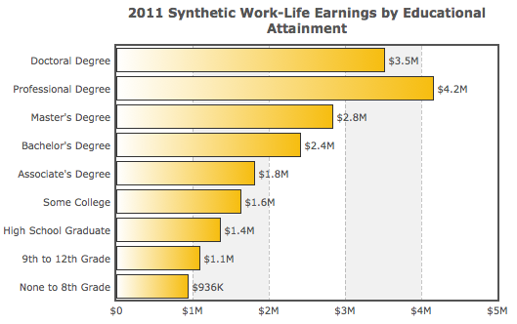
Lifetime impact…
Notes:
This improvement is critical to the individual we serve. Typical house in Kaneohe, $800,000, condo maybe $575,000. $27,000 extra income per year or the $1,000,000 addition of a baccalaureate is critical. This is the difference between your adult children living with you for the rest of their lives or moving out

Slide 24
So…
We’re all in this together – you’ve been a part of early college, even if you didn’t know it
Each improvement that you have worked on for ITS has improved the learning environment for all our students, including early college
Early College is one piece of the puzzle
  brings in students at and then straight from HS who wouldn’t necessarily have come
  helps them succeed to degree

Slide 25


Slide 26

SNEAK PEEK
What’s next?

Slide 27
What about the 56% who are currently working adults?
  1 in 6 people in Hawaiʻi live in poverty
  86% of single mothers in Hawaiʻi live in poverty or are working poor
  19.2% of children in Hawaiʻi live with a single mother (1 in 5)
  The largest predictor of whether a child will get a college degree is if their mother has one.

Slide 28
  Together we can change what it means for our communities and our local families to not just survive but thrive!

Slide 29

Questions?

Slide 30
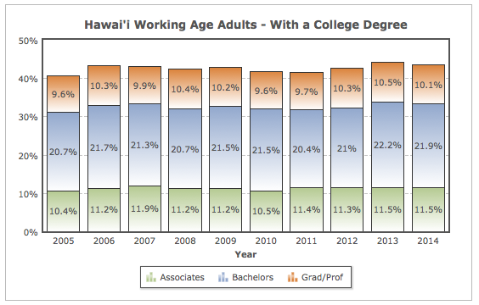
What degrees do we hold?

Slide 31
Windward Community College
Core Values
Ka lama kū o ka naʻauao. Creating meaningful curricula and diverse learning experiences.
ʻAʻohe hana nui ke alu ʻia. Working collaboratively and inclusively.
He pūnūwai kahe wale ke aloha. Serving and supporting with aloha.
Kūlia I ka nuʻu. Striving for excellence.
He ali`i ka ʻāina, he kauwa ke kanaka. Caring for Hawai`i and the planet.

Slide 32

1. Note a fire exists
2.
Put it out

Slide 33
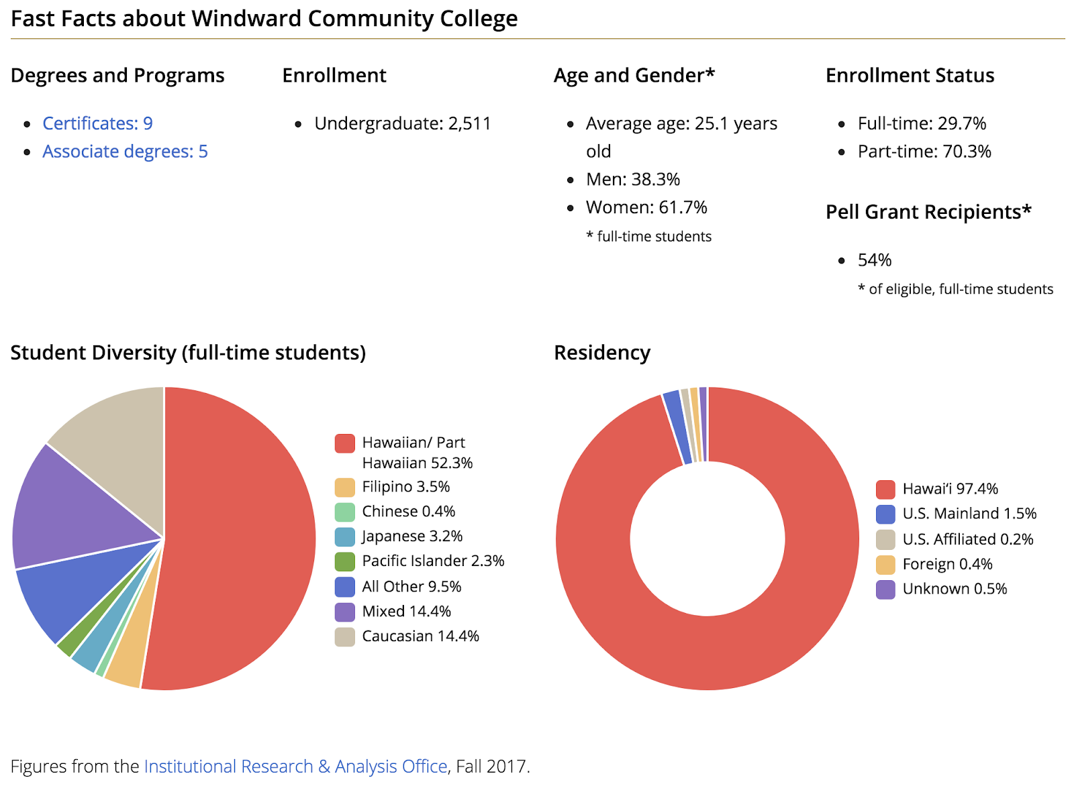
Windward Community College
Notes:
Demographics:
Suburban Campus - Rural Communities
80% A.A. Liberal Arts
A.S. Natural Science - fastest growing
Enrollment: 3533 (39% NH)
Pell participation rate: 54% (all), 63% (NH)

