Slide 1
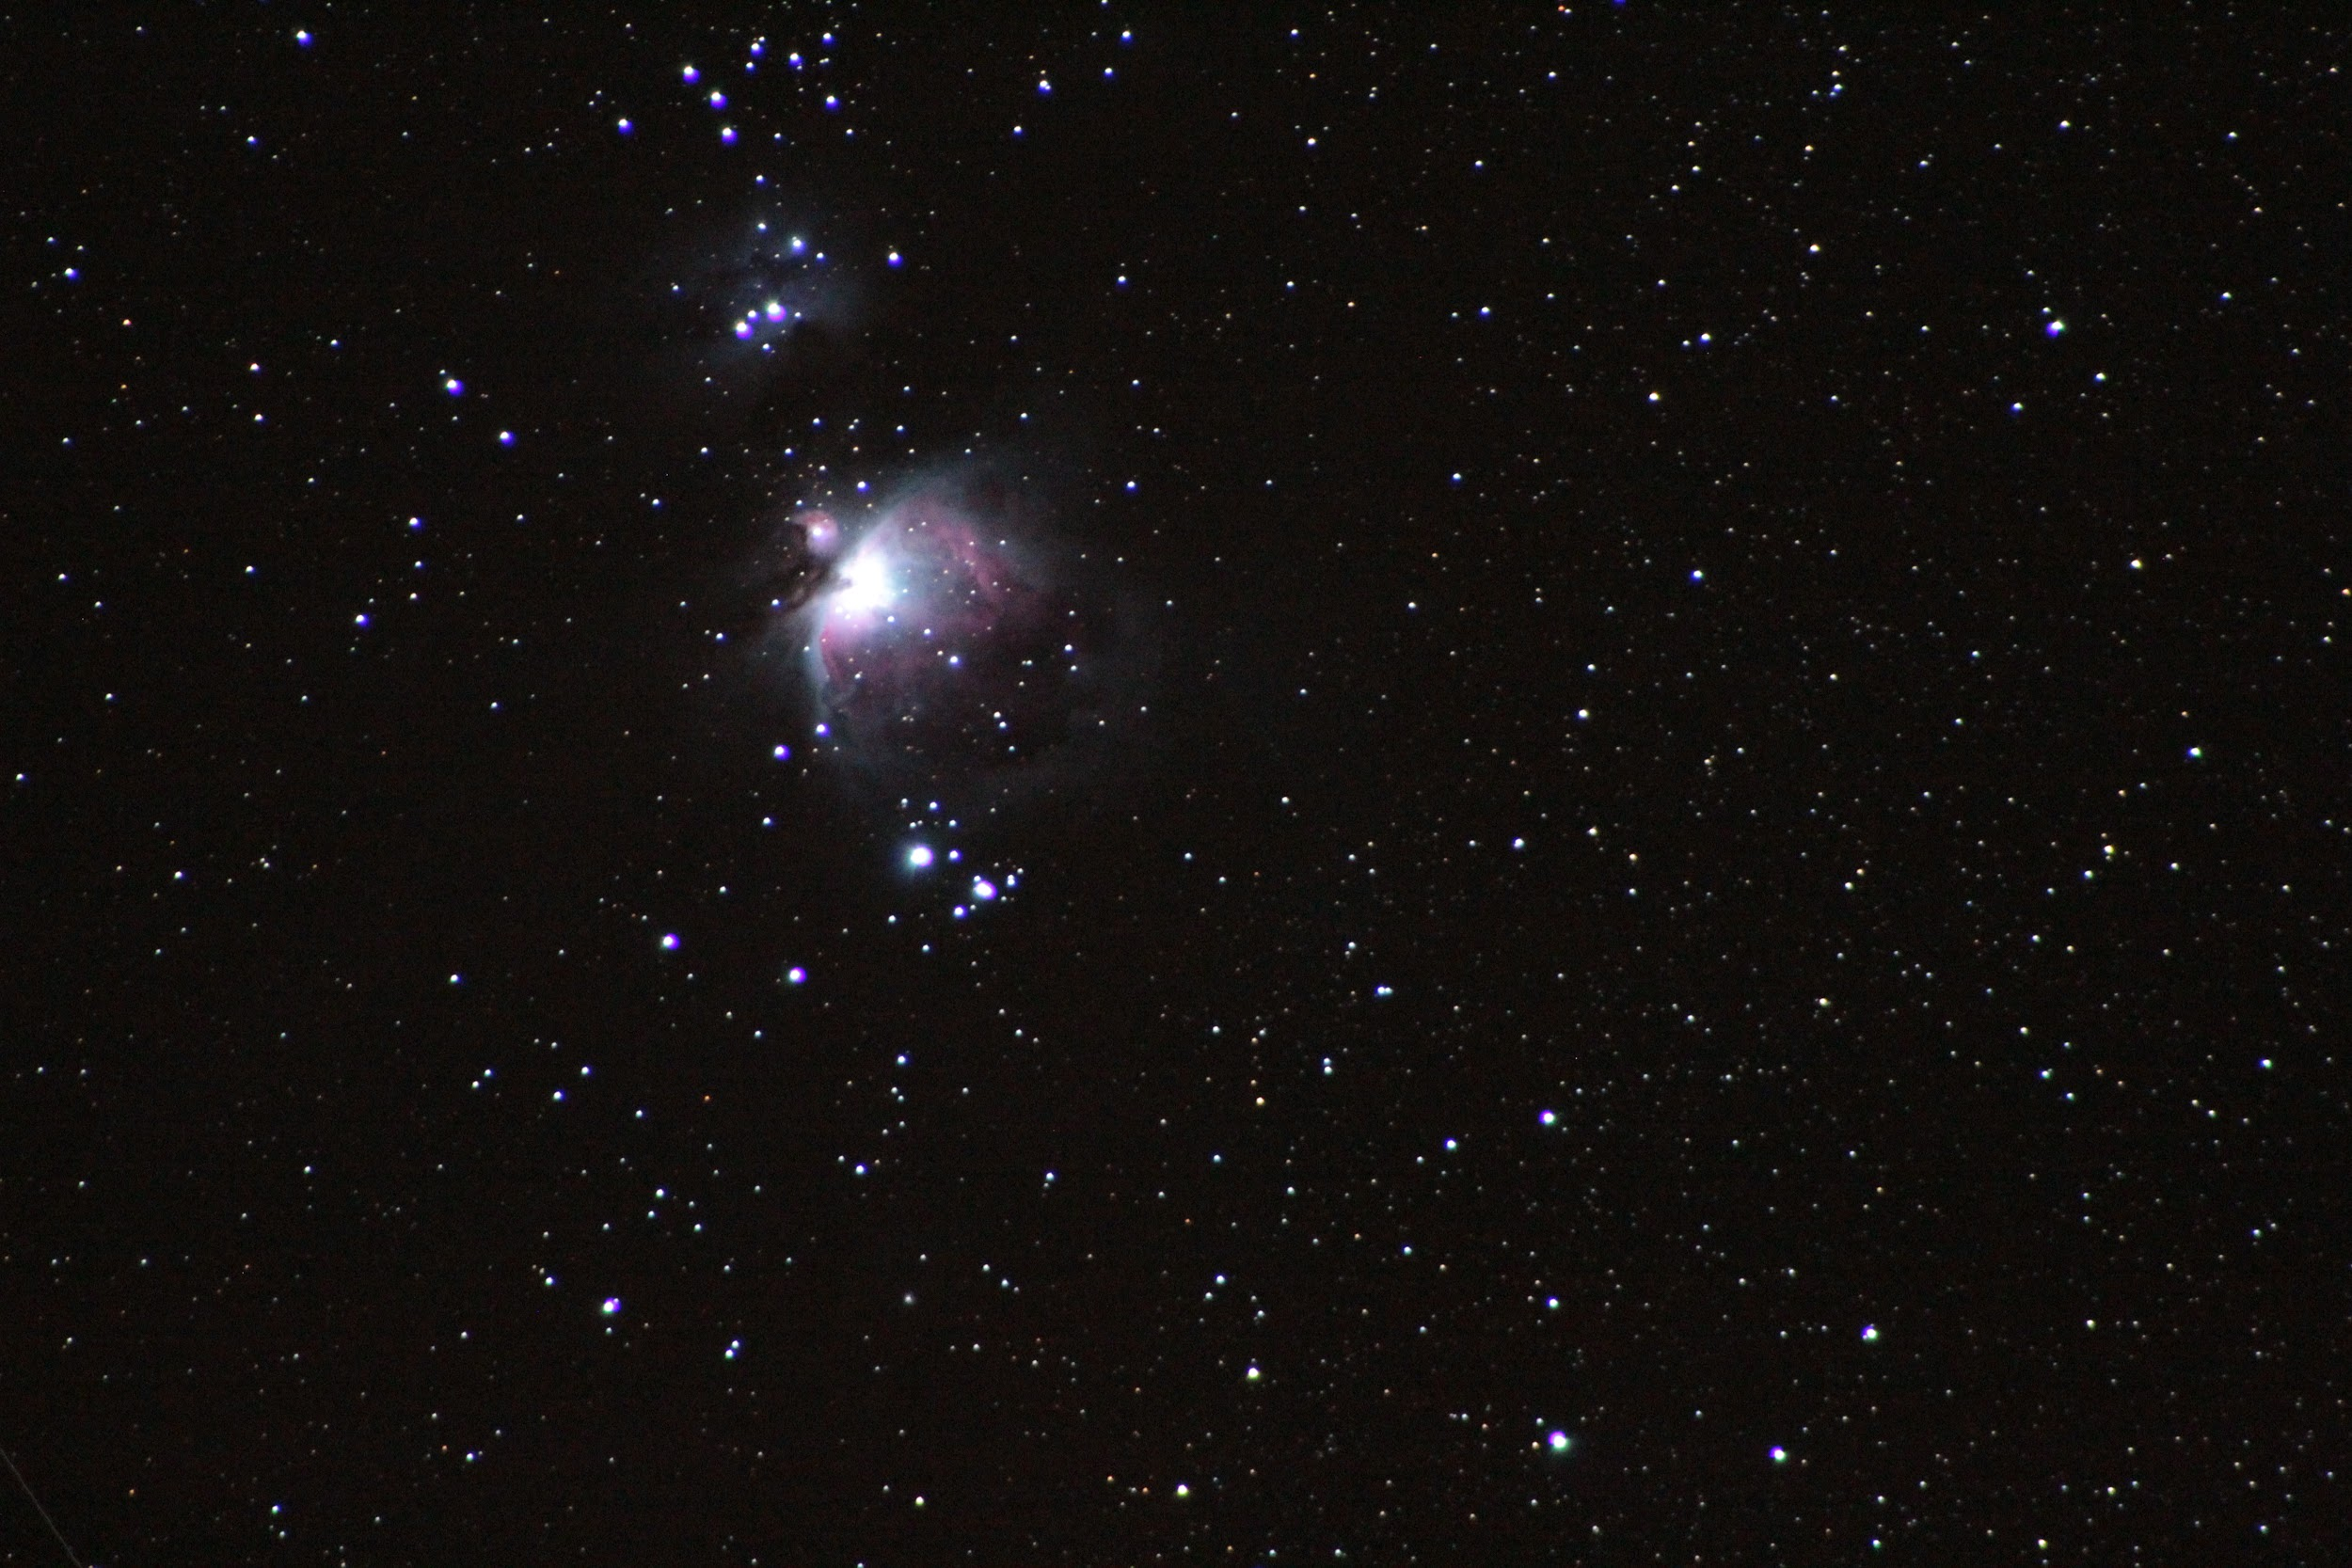
Hawai‘i AstroFlows
Curt Dodds, Institute for Astronomy

Slide 2
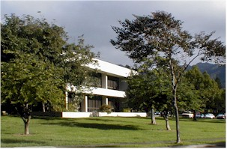
Institute for Astronomy (IfA)
John Jefferies founded the Institute for Astronomy at the University of Hawai‘i on July 1, 1967.
“Organized Research Unit”
University of Hawai‘i , Mānoa
~175 employees
~45 faculty
~35 grad students

Slide 3
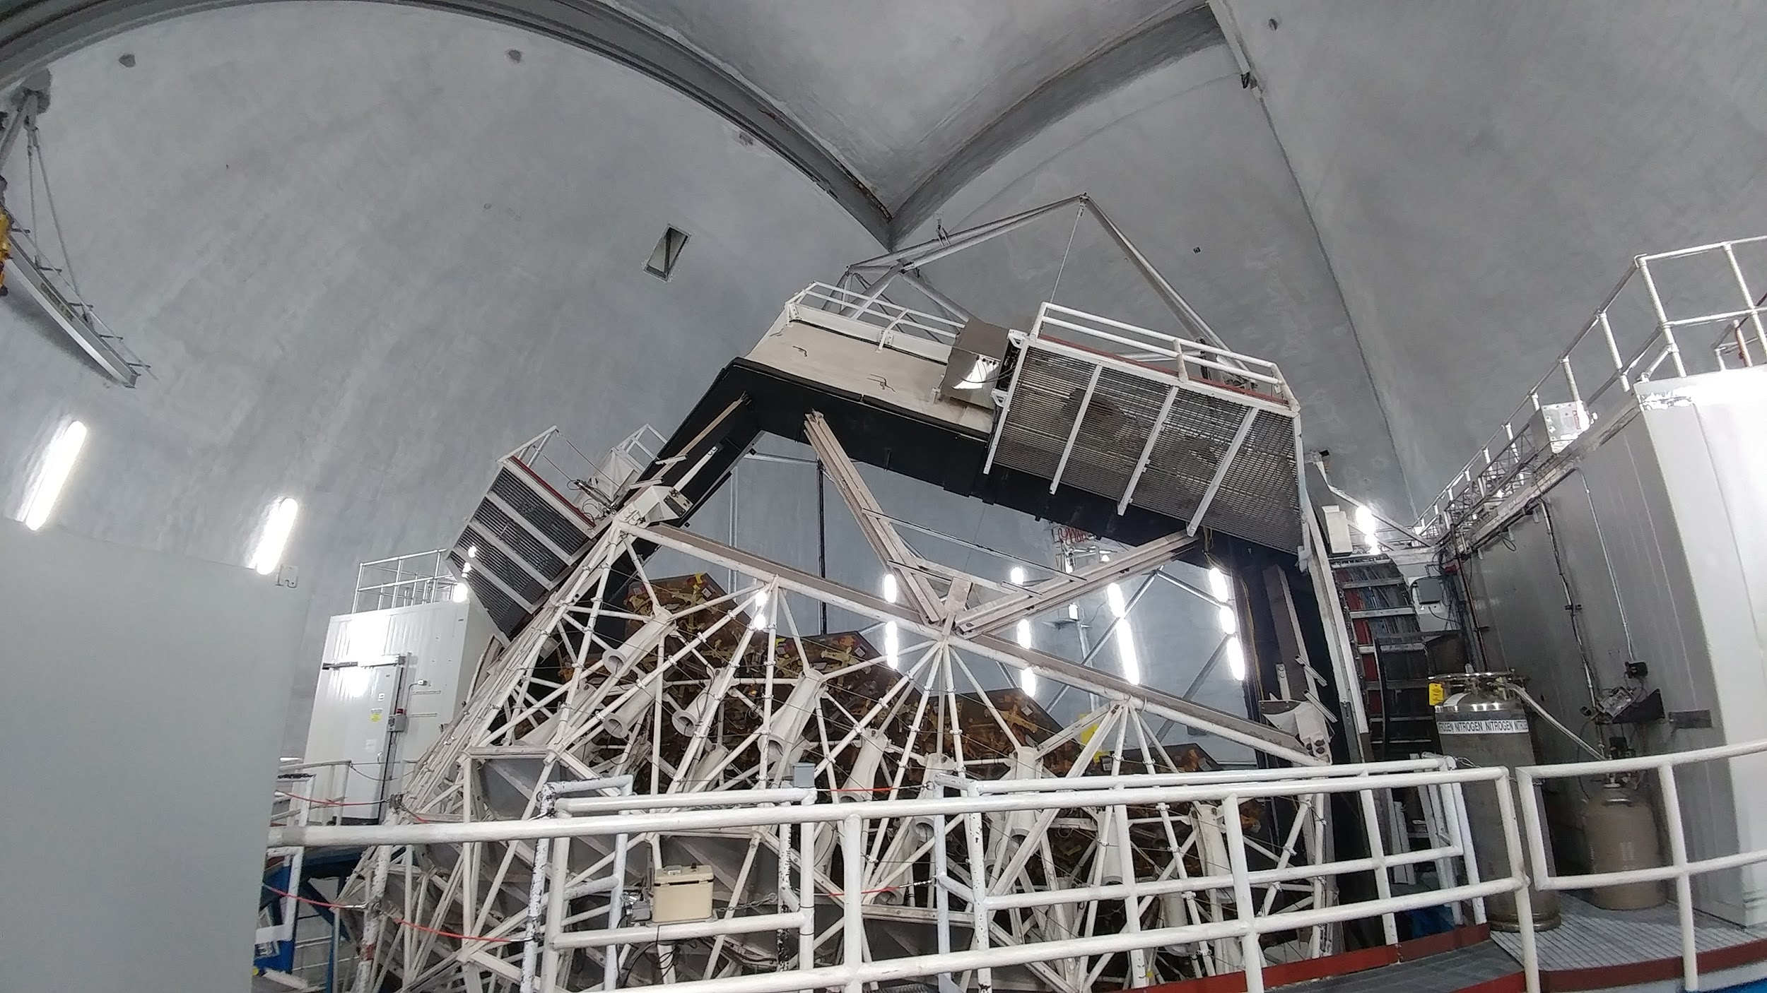
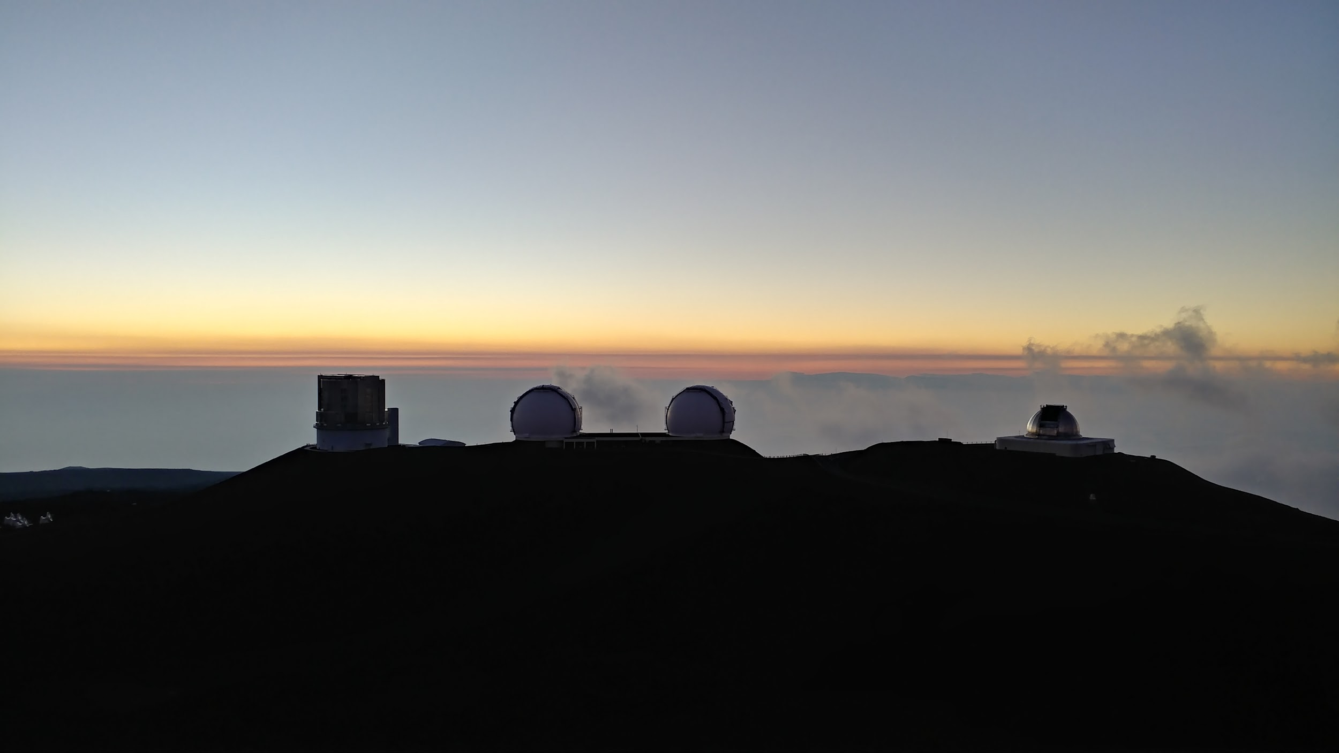
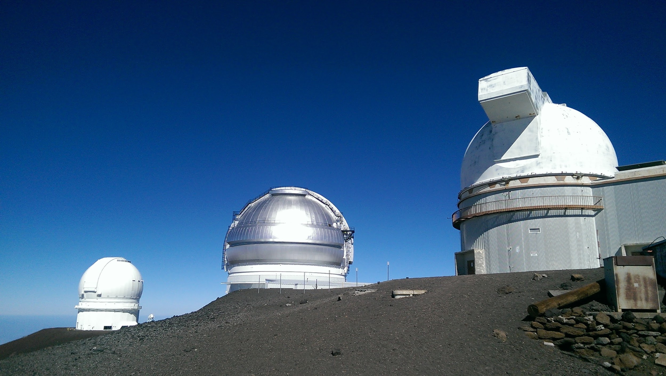
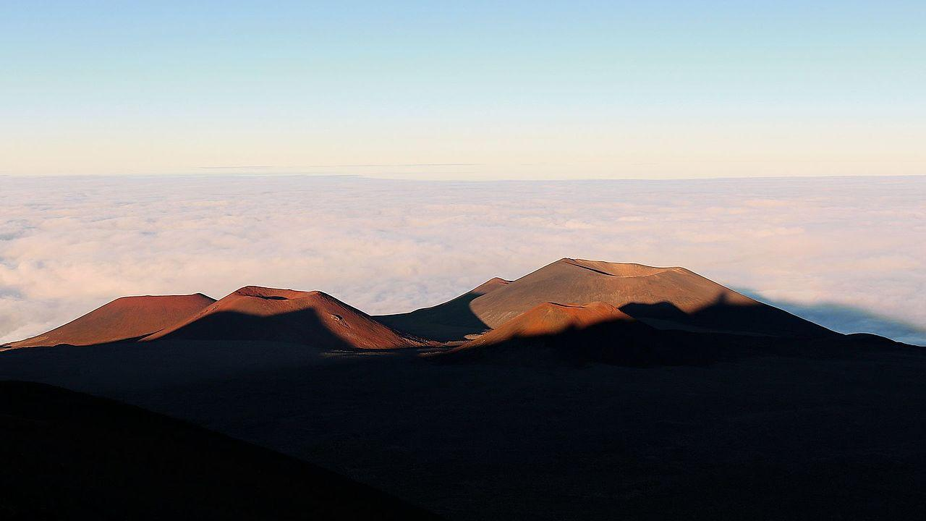
Maunakea Observatories
11 national and international observatories
12 telescopes: visible, infrared, submillimeter, radio

Slide 4
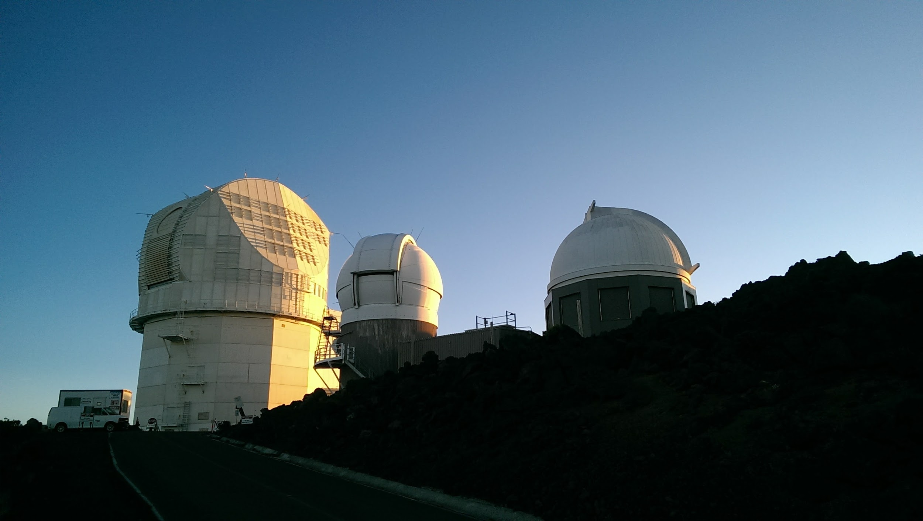
Haleakalā Observatory
left to right:
NSO:
DKIST
IfA:
Pan-STARRS PS1 and PS2
ATLAS and ASAS-SN not shown.

Slide 5
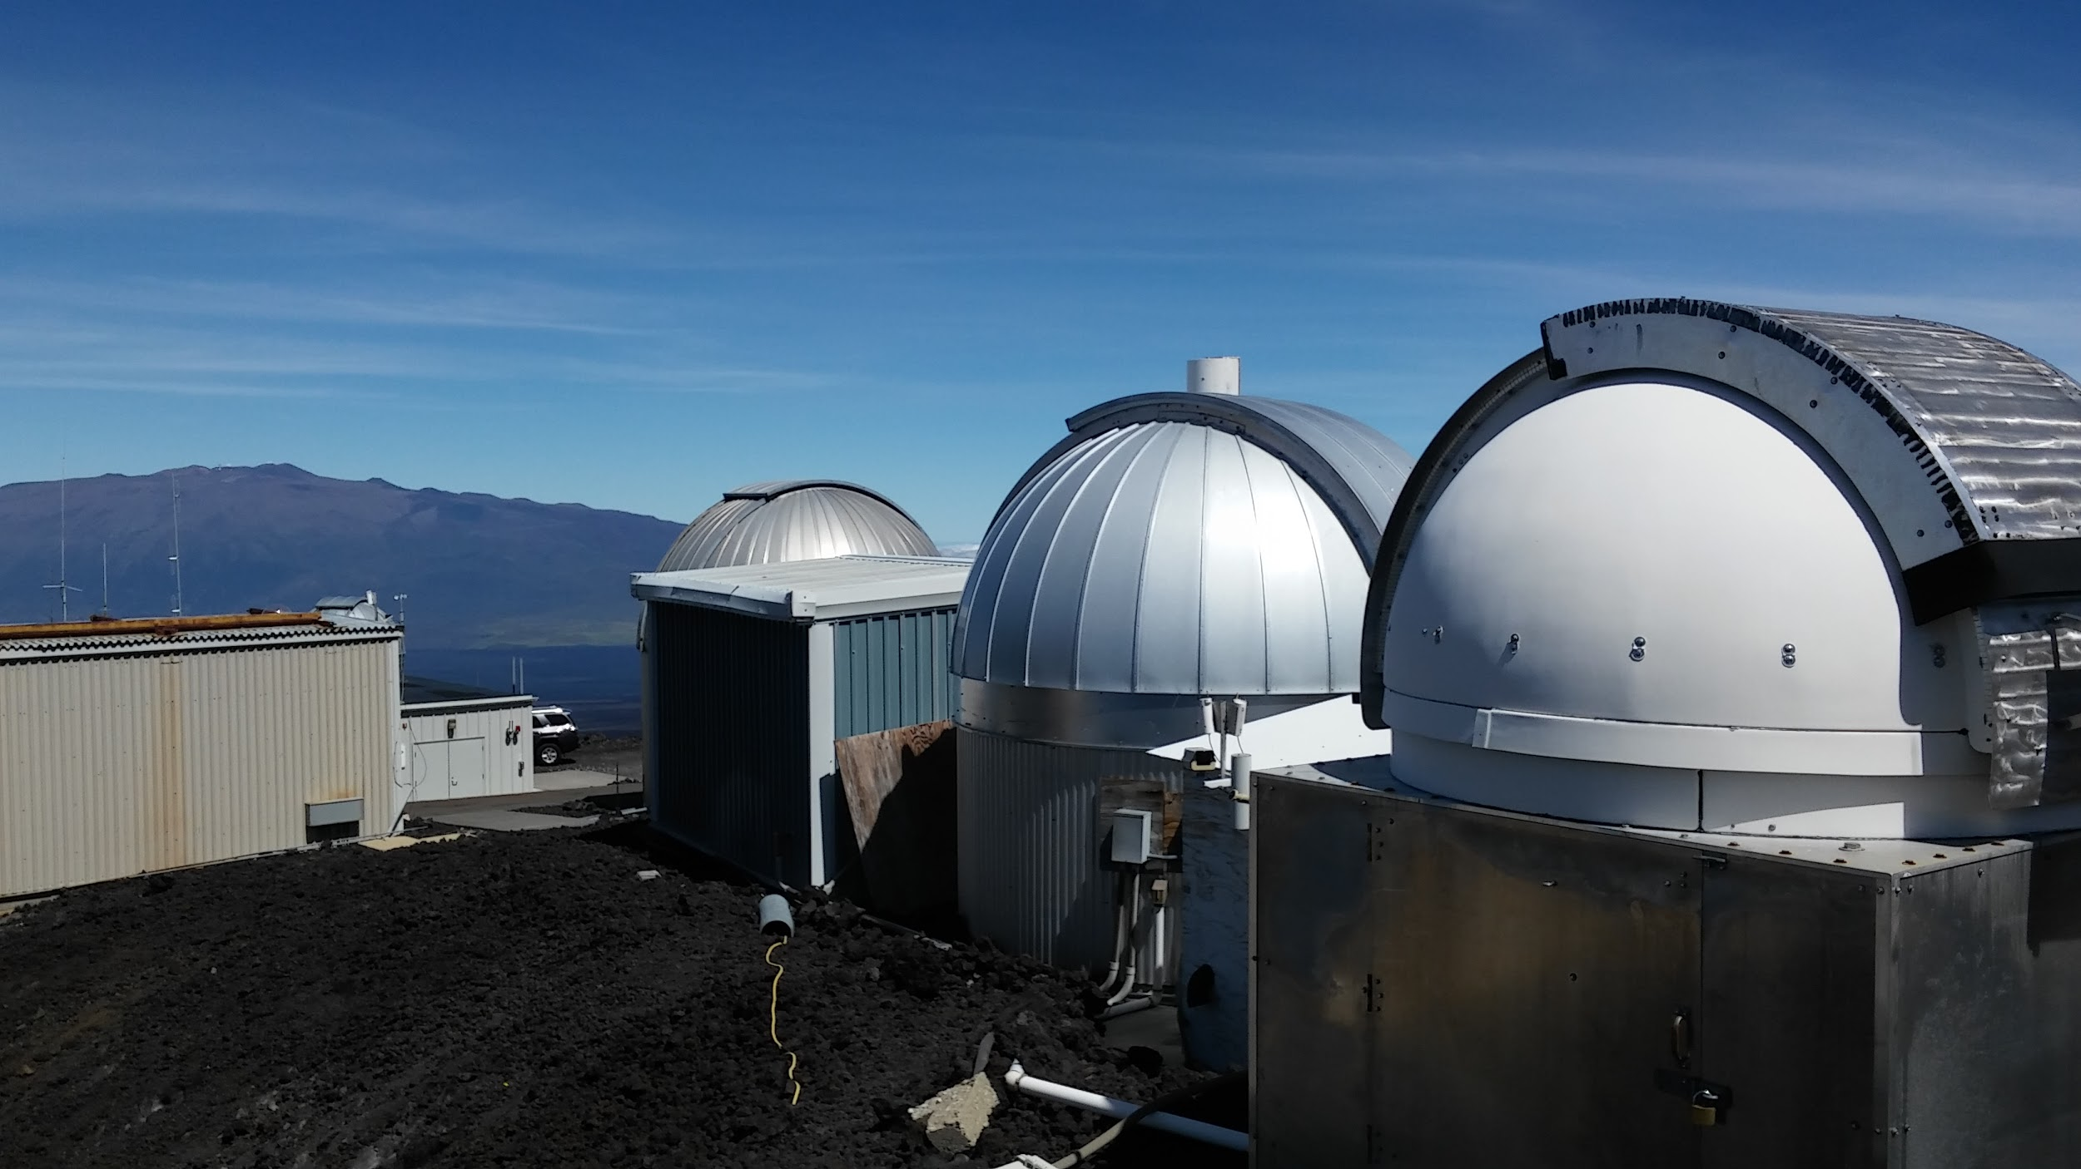
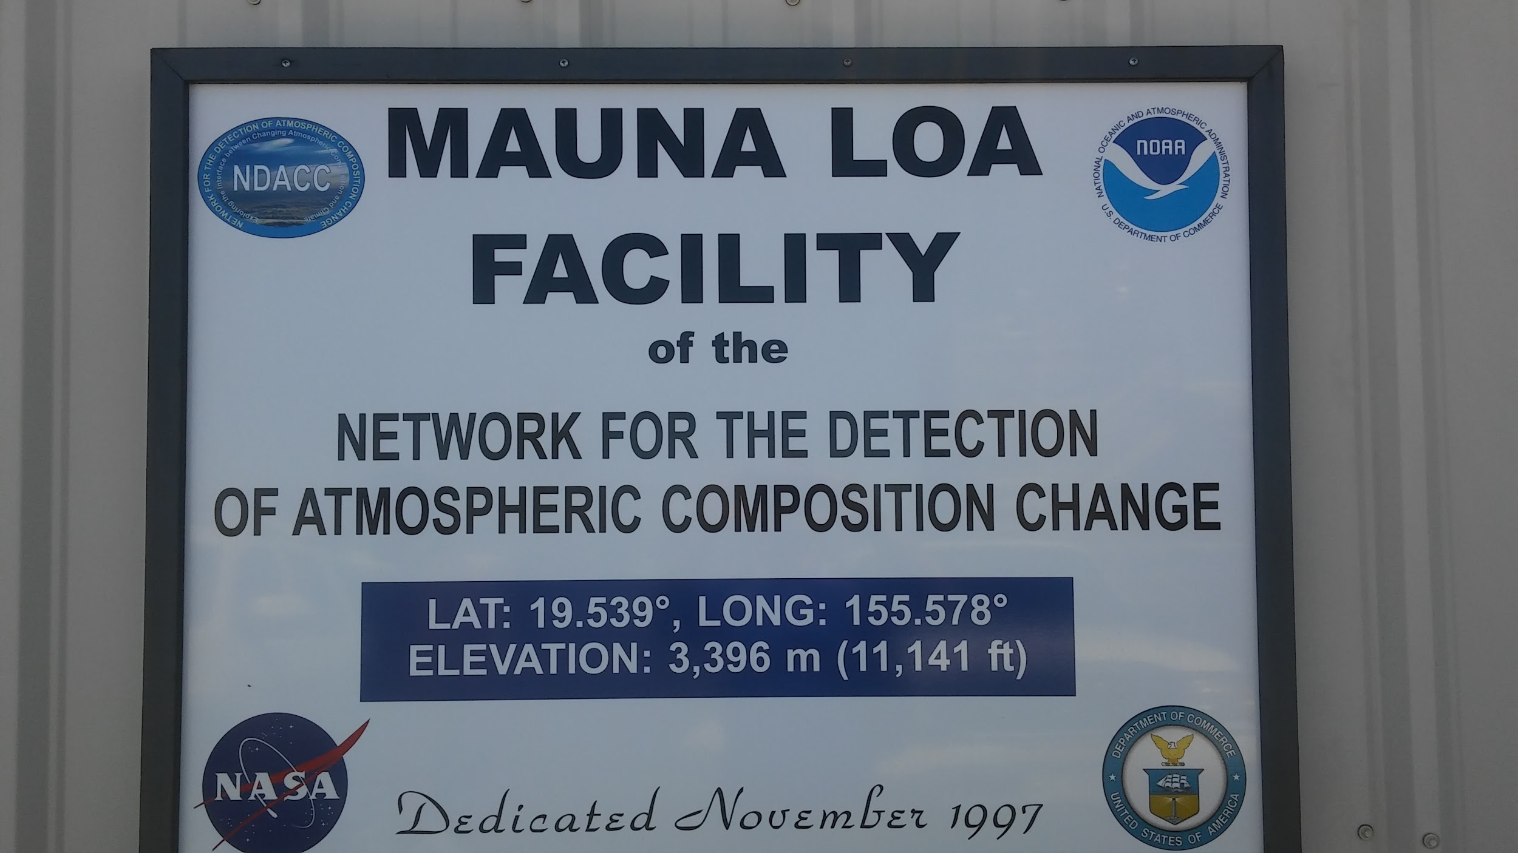
Mauna Loa Observatory
University of Hawai‘i
US Naval Observatory
US Geological Survey
National Oceanic and Atmospheric Administration
National Center for Atmospheric Research
… and more

Slide 6
Internet2 Global Summit 2017
NetSage presentation by Jennifer Schopf, IU
This got me thinking …
Could we capture all science flows in and out of UH “astronomy subnets”?

Slide 7
Internet2 Global Summit 2017
Could we capture all science flows in and out of UH “astronomy subnets”?
I talked to my colleagues at each observatory about this and concluded that, yes, we could!
A 2018 measurement goal for “PIREN” (NSF)

Slide 8
The AstroFlows team:
Adriana Comerford
Alan Whinery
Chris Zane
David Schanzenbach
Gwen Jacobs
Myself

Slide 9
Project Objectives
Top Down
How is the astronomy community utilizing the UH campus and REN and IRNC infrastructure?
Bottom Up
Are science data flows performing optimally?

Slide 10
Our methods
Configure edge routers to capture flows
Configure NfSen server to collect and store flows
Map UH "astronomy subnets" to science entities
Validate nfdump sampling accuracy
Use nfdump to analyze flows by science entity (source) and remote institution (destination)
Invert above to analyze inbound traffic

Slide 11
Analyze flows by science entity and remote ASN
Map UH subnets to (astronomy) science entities
Collect flows (netflow, sflow)
Run a script to collect flows using nfdump
Run a script to generate subnet to AS map
Run a script to aggregate flows over time range

Slide 12
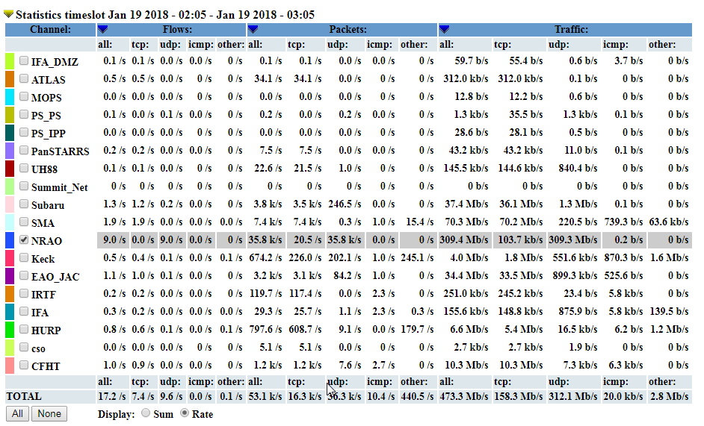
NfSen AstroFlows - NRAO selected

Slide 13
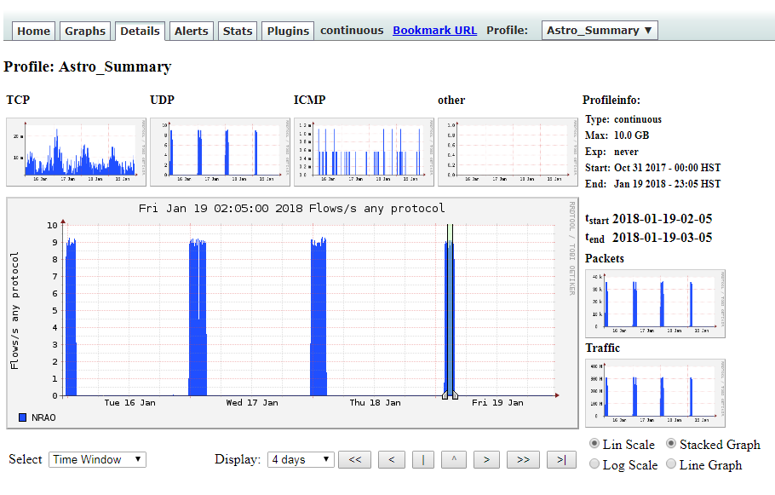
NfSen flow sample - 1 hour NRAO (VLBA)

Slide 14
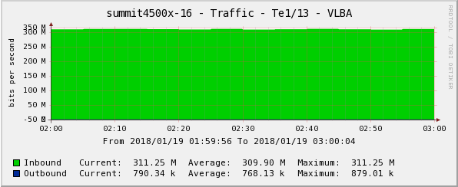
Cacti graph from switch

Slide 15
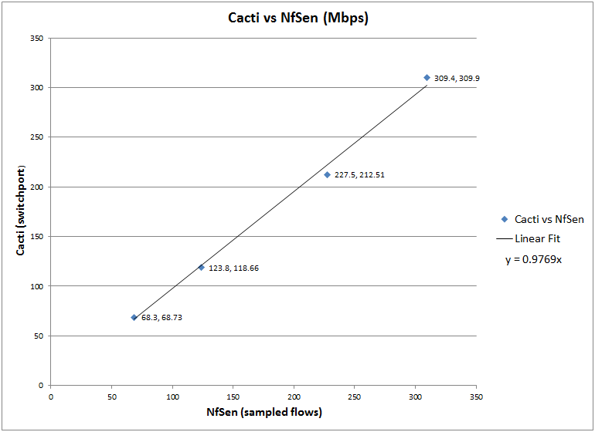

Slide 16
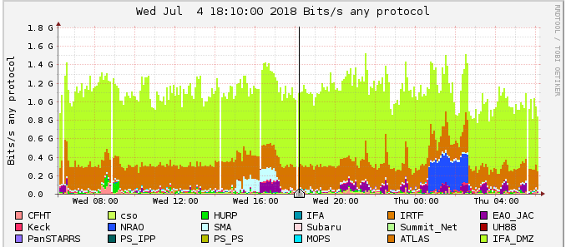
24 hours of Astroflows
Yellow 1.1Gbps
Pan-STARRS Data Release 2 file transfer
Manoa to Baltimore, Maryland

Slide 17
24 hours of Astroflows
Orange 250 Mbps
ATLAS data transfer
Manoa to Belfast, Ireland

Slide 18
24 hours of Astroflows
Blue 311 Mbps
NRAO data transfer
Hilo to Socorro, New Mexico

Slide 19
24 hours of Astroflows
Magenta 106 Mbps
UKIRT data transfer
Hilo to Cambridge, England

Slide 20
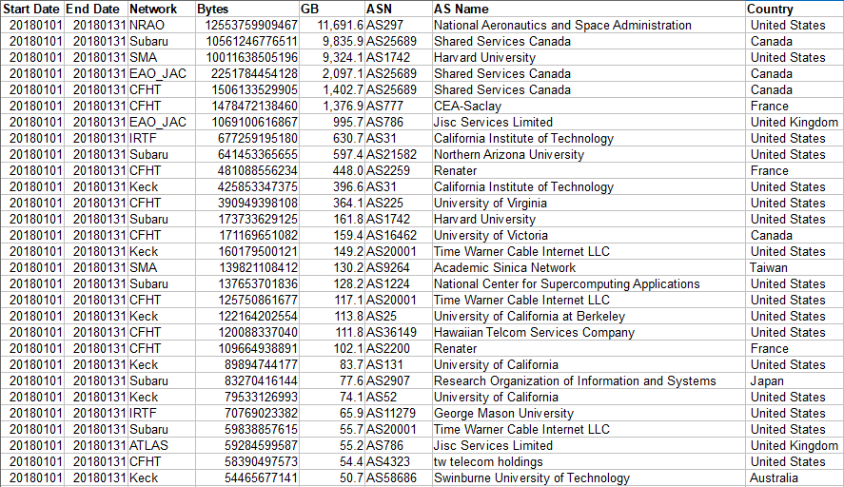
One month of astroflows we NOW know about!

Slide 21
Measure and Improve Data Transfer Performance
Pan-STARRS - Periodic data releases
Manoa to Baltimore, Maryland (STScI)
Baseline: 10TB in October 2016 - peak 340Mbps

Slide 22
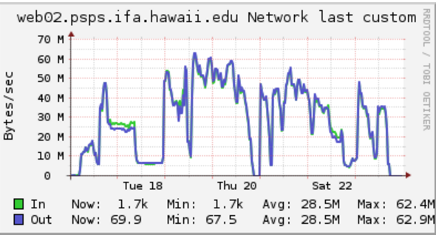
Pan-STARRS Data Release 1 (PS1 DR1)
PS1 DR1 Updates October 2016

Slide 23
Measure and Improve Data Transfer Performance
Pan-STARRS - Periodic data releases
Manoa to Baltimore, Maryland (STScI)
Baseline: 10TB in October 2016 - peak 340Mbps
Result: 100TB in June/July 2018 - peak 1.1Gbps

Slide 24
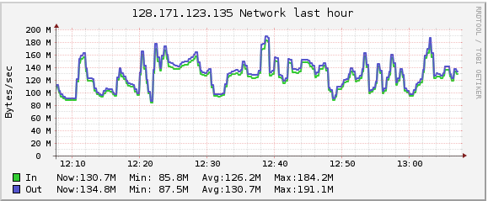
Pan-STARRS Data Release 2 (PS1 DR2)
PS1 DR2 June-July 2018

Slide 25
Try it yourself!
Astroflows:
https://github.com/edubergeek/astroflows.git
NfSen:
http://nfsen.sourceforge.net/

