Slide 1
CSOC – Help Desk Updates
Claire chun

Slide 2
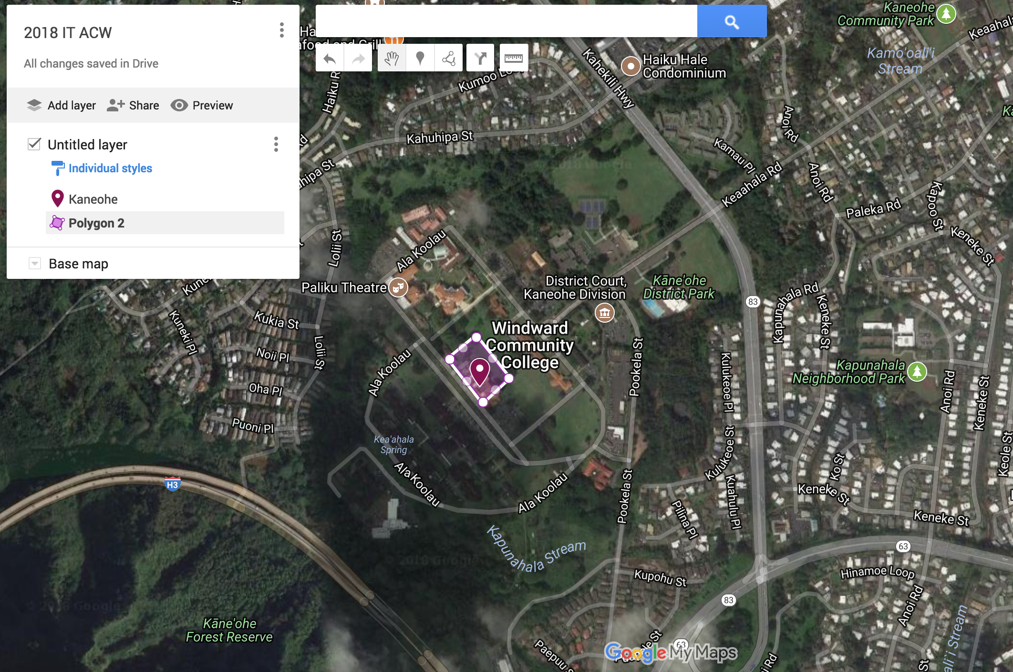
Google@UH
Google Consumer Apps
Developers Console
My Maps
Take Out
Custom Search
Alerts
Material Gallery
https://www.hawaii.edu/google/extra/
Notes:
You can see more consumer apps if you’ve allowed for this feature at hawaii.edu/google/extra

Slide 3
New Gmail UI

Slide 4
New Gmail UI
gCal
Keep
Tasks
Choose calendars and view your day at-a-glance
Take quick notes in Google Keep in Gmail or the Keep app
Create tasks in Gmail or in the Tasks app

Slide 5
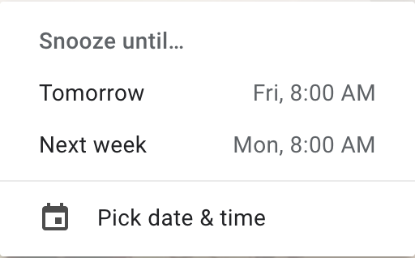
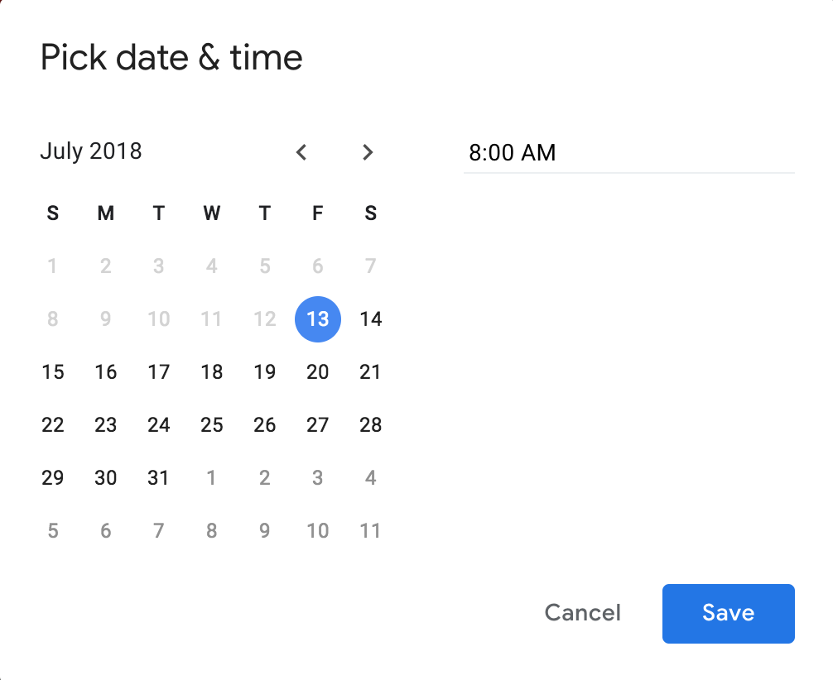
Gmail Snooze

Slide 6
How can we help you?
Systemwide 24 hours-a-day, 7-days-a-week, 365 days-a-year
Walk-in support 8-4:30
Help desk support by email, phone, and remote desktop
2 general purpose computer labs
Monitoring production services & network activity
Facilitation to the ITC Data Center
(808) 956-8883
help@hawaii.edu

