Slide 1
Enterprise Content Management
University of Hawaiʻi
July 13, 2018

Slide 2
What is Enterprise Content Management (ECM)?
“Capture, manage, store, preserve and deliver content and documents related to organizational processes”

Slide 3
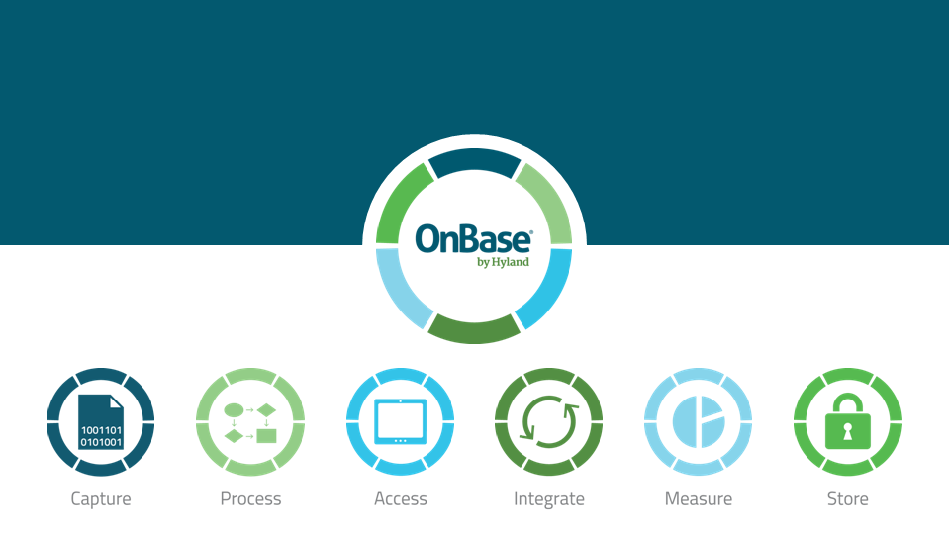
OnBase
Enterprise Content Management System
Hyland Software
Contract - July 2017

Slide 4
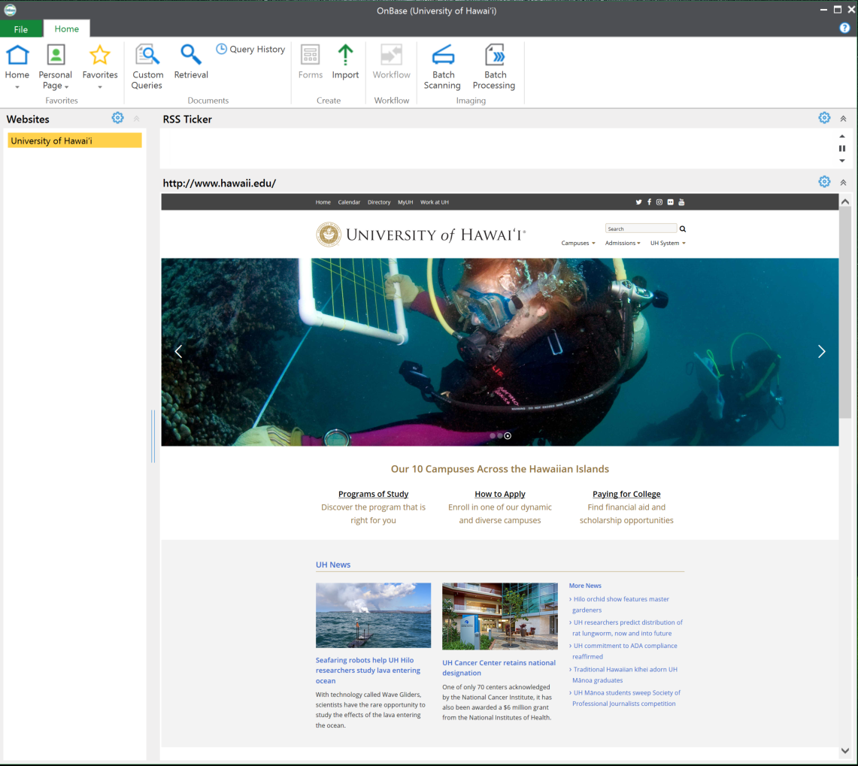
OnBase at UH
Base Implementation
System installation and configuration
Completed - March 8, 2018
Health Clearance Solution
Student Health Clearance forms
Single, system-wide solution
Scan, Store, Retrieve
One-way integration with Banner

Slide 5
ECM Project Portfolio
Scan, Store, Retrieve
Human Resources
Procurement and Real Property Management
ACCESS office (College of Social Sciences)
Workflow
Data Governance
Change of Major Request
Enrollment Management (Mānoa, West Oʻahu, Hilo)
Risk Management
Electronic Forms
User Access Request
Scanner Loan

Slide 6
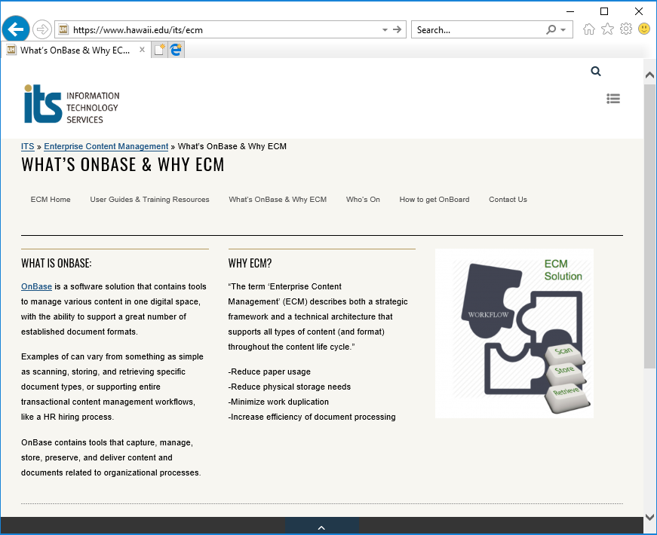
Contact Us
ITS Enterprise Content Management Team
Educate
Design
Configure
Develop
Support
email: ecm-support@lists.hawaii.edu website: https://www.hawaii.edu/its/ecm
Scott Ogasawara
Jesse Tom
Diana Hamasaki
Christopher Chan

